Slide 1
The average US household uses about 10 megawatt-hours per year (actually 11, but 10 for simplicity)(link)
Coal Waste: 1850 pounds of ash / megawatt
Hydropower: 28 pounds of waste / megawatt
Natural Gas: 970 pounds of CO2 / megawatt (https://www.eia.gov/tools/faqs/faq.php?id=74&t=11)
Solar: 32 pounds of waste / megawatt
Nuclear: 0.007 pounds of waste / megawatt
Data Visualization Track
For this track, your group will tell a story using data visualizations. Here are the specific requirements:
Your project must include visualizations. The visualizations can be created with:
Python (e.g. Matplotlib, Pandas plotting, hvplot)
JavaScript (e.g. Plotly or Leaflet)
A Python or JavaScript visualization library that was not covered in class
Data must be stored in and extracted from at least one database (PostgreSQL, MongoDB, SQLite, etc).
Your project must include at least one JavaScript OR Python library that we did not cover.
Your project must be powered by a dataset with at least 100 records.
Your project must include some level of user-driven interaction, such as:
HTML menus, dropdowns, and/or textboxes to display JavaScript-powered visualizations
Flask backend with interactive API routes that serve back Python or JavaScript created plots
Visualizations created from user-selected filtered data, which could be powered by:
JavaScript libraries
Python in Jupyter Notebook
Command-line Python scripts that save visualizations locally
Remember: You have learned how to filter data in Pandas, JavaScript, SQL, SQLAlchemy, and MongoDB.
If possible, your final visualization should ideally include at least three views.
Your GitHub repo must include a README.md with an outline of the project including:
An overview of the project and its purpose
Instructions on how to use and interact with the project
At least one paragraph summarizing efforts for ethical considerations made in the project
References for the data source(s)
References for any code used that is not your own

Slide 2
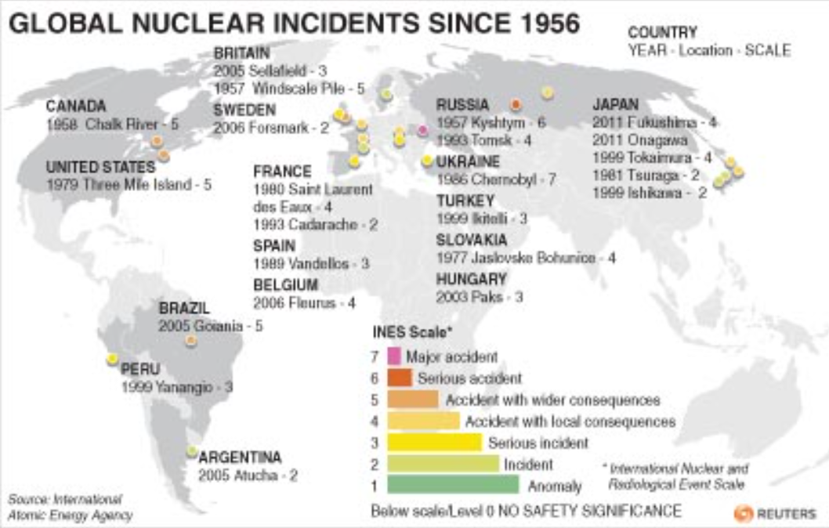

Slide 3
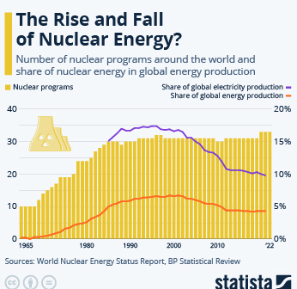
How has the distribution of nuclear power plants changed in the last 40 years?
What are the top five countries based on nuclear power generation?
Which countries are adopting nuclear power the fastest?
What percentage of energy is produced using nuclear power?
By what year, based on current trends, will 50% of the world be powered by nuclear?

Slide 4
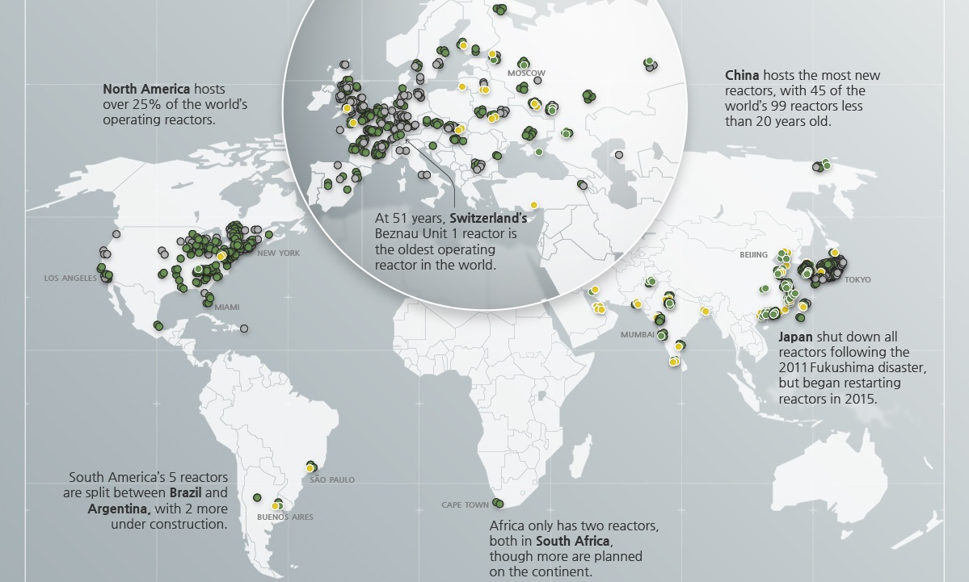

Slide 5
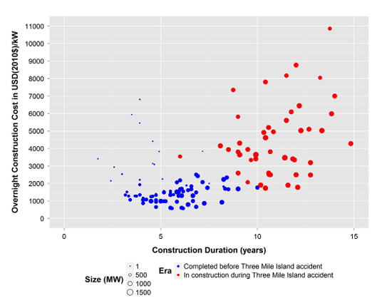

Slide 6
